Slide 1
2017 Netflix Stock Profile
Prepared by Asad Al-Naqeeb
Visualization Developer~Yahoo Finance

Slide 2
List and summary of Visualizations:
Netflix Quarterly Data: Distribution of Netflix quarterly stock prices for 2017.
Performance of EPS (Earnings Per Share): Estimate earnings Yahoo projected for the quarter compared to the actual earnings.
Earnings and Revenue: Side-by-Side earnings and revenue reported by Yahoo per quarter.
Netflix vs Dow Jones industrial Avg: Compare Netflix stock to the Dow Jones industrial average for 2017.
As the visualization developer for Yahoo I was tasked with creating visuals to assist in explaining the stock performance for Netflix for physical year 2017 utilizing Python coding visualization tools.

Slide 3
Summary of Neflix Quarterly Data
The following slide will demonstrate netflix quarterly stock performance for 2017, and it clearly demonstrates that the 3rd quarter was the most volatile based upon the changes in stock prices during that particular quarter. There were several moments where the prices fluctuated between extreme highs and lows.

Slide 4
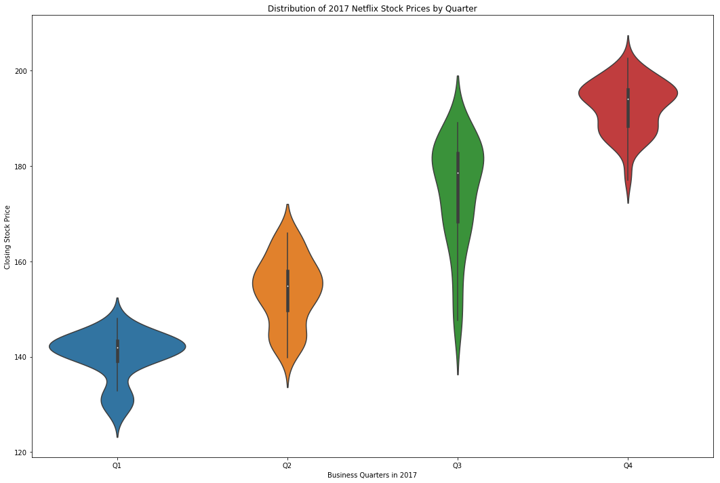
Netflix Quarterly Data

Slide 5
Earnings Per Share Summary
Our next slide shows that Yahoo’s quarterly projections for year 2017 were accurate for the most part. During the 1st quarter, Netflix actual earnings exceeded Yahoo’s projections. While their 2nd and 4th quarter projections were spot on. However, their 3rd quarter projections were off, but not significantly.

Slide 6
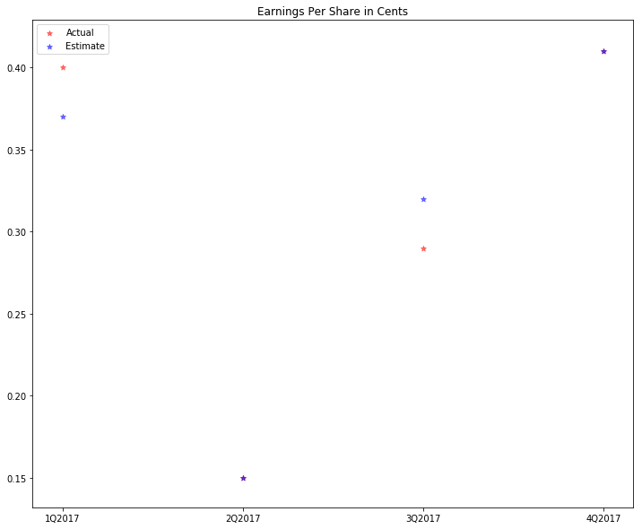
Performance of EPS

Slide 7
Earnings and Revenue
Netflix does not at this time demonstrate enough earning potential to be a safe enough investment of any major capital due to their small earnings compared to their overall revenue for 2017. However, the upside is that they consistently increased earnings as revenue increased which would allow for some investment potential in the future if those trends continue.

Slide 8
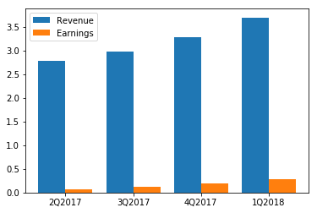
Earnings and Revenue

Slide 9
Netflix vs Dow Jones Industrial Avg.
Lastly, we will observe a side-by-side comparison between the netflix stock prices as opposed to the Dow Jones industrial Average. Netflix shows that they are on par with the Dow average, however, Netflix is more volatile as far as their price fluctuation. I would say that despite their volatility, they followed the overall uptrend of the Dow Average.

Slide 10
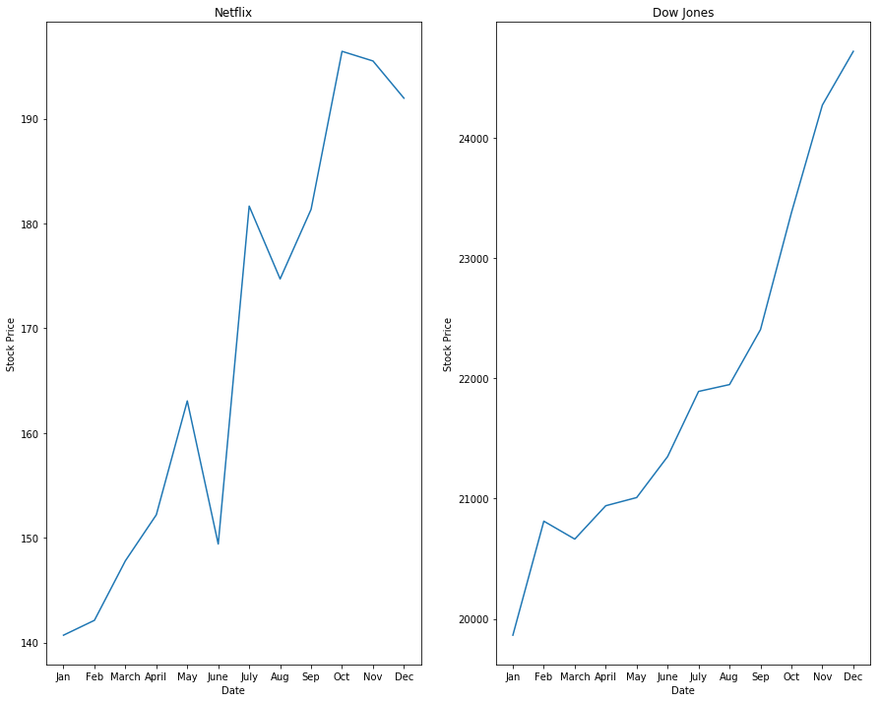
Netflix vs Dow Jones Industrial Avg

